Slide 1






P993-Adventure Works Project

Slide 2

Group-6 Members
Kishore Kumar Agidi
Manisha Ponnam
Pranay Siddharth Gaikwad
Shivani Wakde
Swetha Vani Kami Reddy
Vishal Rajput

Slide 3
Summary
Project Overview:
The Adventure Works Project aims to provide a comprehensive and interactive visualization of key sales metrics of Adventure Works Cycles, a global bicycle manufacturer. This dashboard is designed to enhance decision-making by offering insights into product performance, regional trends, and customer behavior.
Objectives:
Design interactive dashboards using Excel, Tableau and Power BI
Write optimized SQL queries for data extraction and analysis
Identify key performance metrics like sales trends and regional performance
To support data-driven decision-making for stakeholders.

Slide 4
Challenges
Raw dataset had inconsistent values.
Required breakdown of a single date column into multiple time-based features.
Integration of multiple data sources using pivot table features.
Creating consistent KPIs across Excel, Power BI, and Tableau.
Ensuring interactivity with optimal performance.
Handling customer and product information.
Used Data modelling techniques to achieve accurate analysis for DATE values.
Designing intuitive dashboards with minimal clutter.

Slide 5
Solutions
Applied Power Query for cleaning and transforming raw data.
Created calculated columns for Year, Month, Quarter, and Weekday using formulas and DAX.
Used relationships to enrich data with product and customer details.
Defined standardized KPIs and reused logic across all tools.
Implemented slicers, filters, and visual cues to ensure clarity and interaction.
Prioritized clarity and performance in dashboard layout design.
Validated outputs across platforms to maintain uniformity.

Slide 6
KPI’S & Insights
Total Sales
29.36 M
1. Sales : Total Sales
Profit Margin
41.15 M
2.Profit Margin : Total Profit Margin
Total Profit
12.8 M
3. Profit : Total Profit
Total Orders
60 K
4. Orders : Total Orders

Slide 7
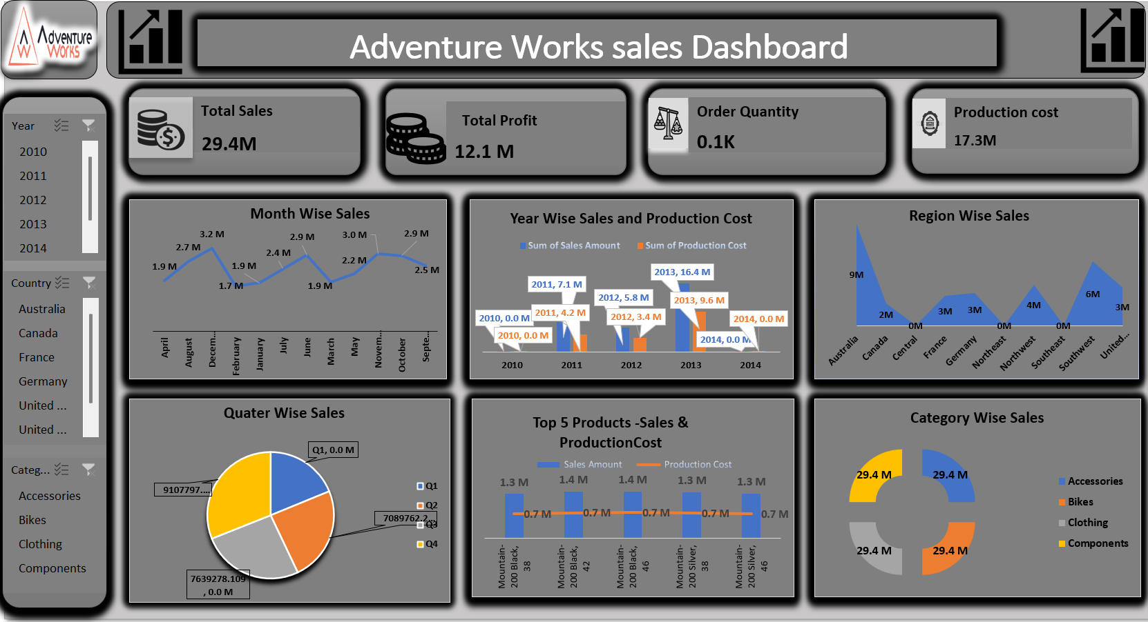
Excel

Slide 8
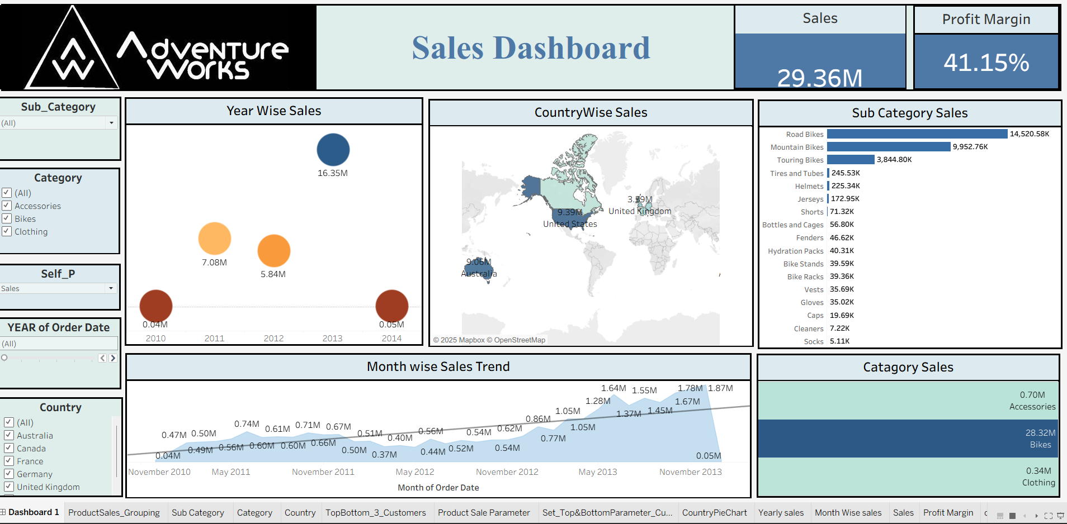
Tableau

Slide 9
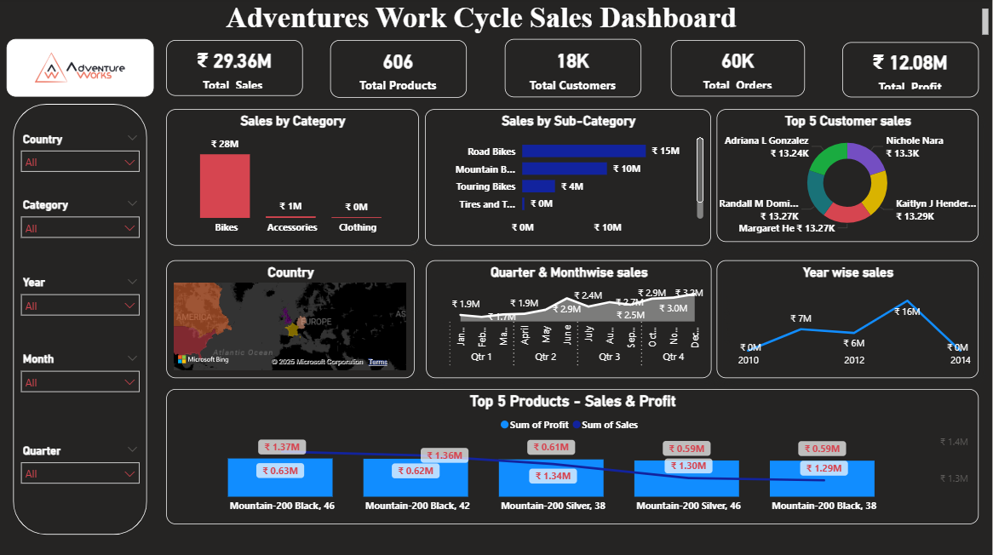
Power BI

Slide 10
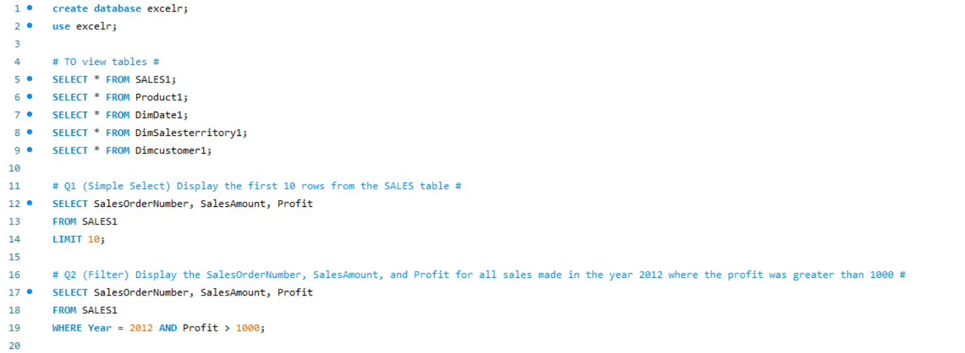
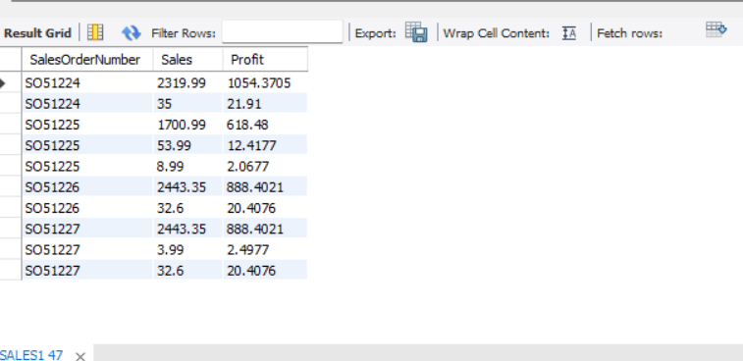
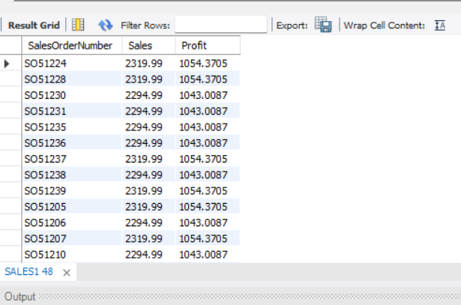
SQL

Slide 11
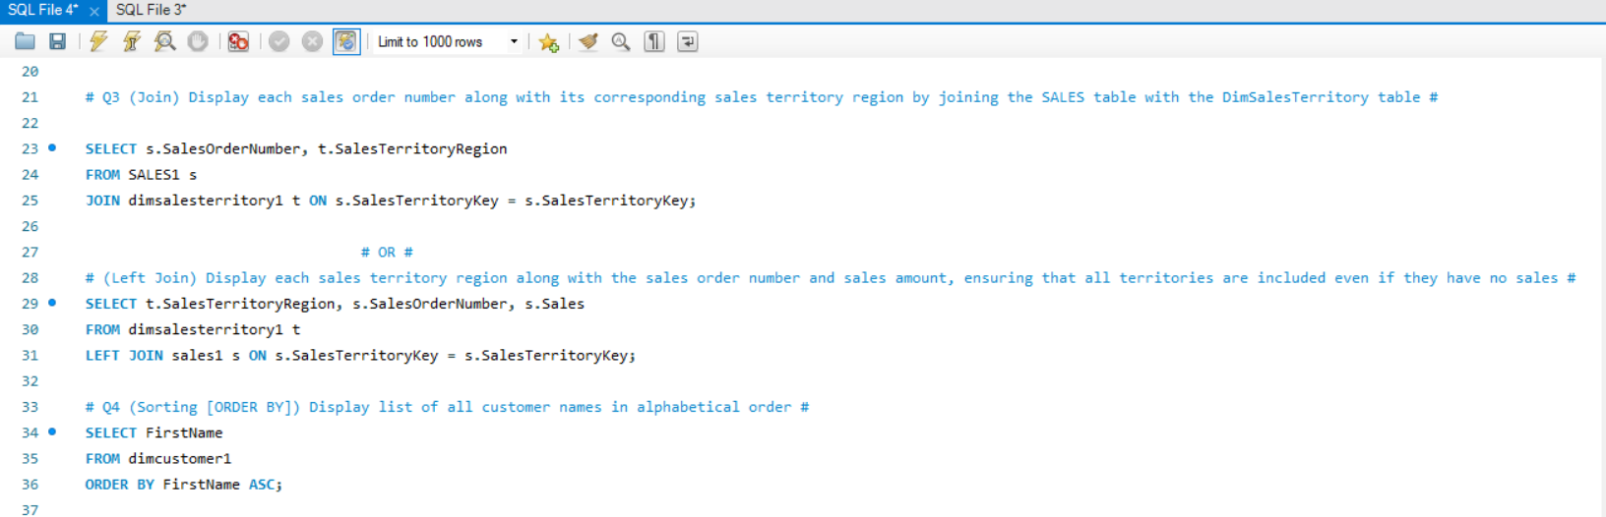
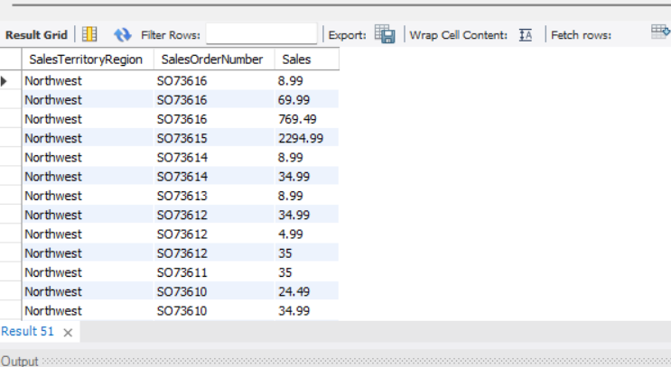
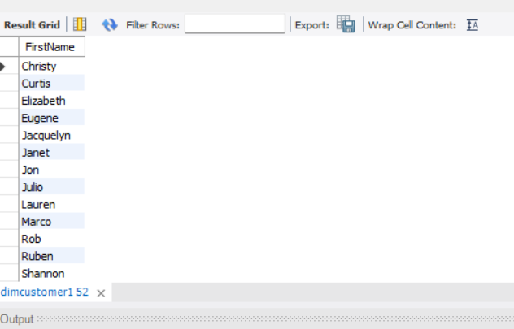
SQL

Slide 12
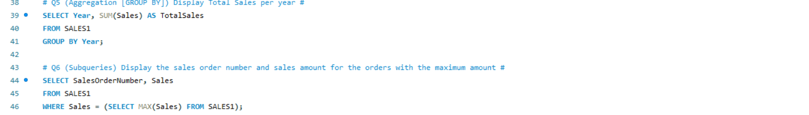
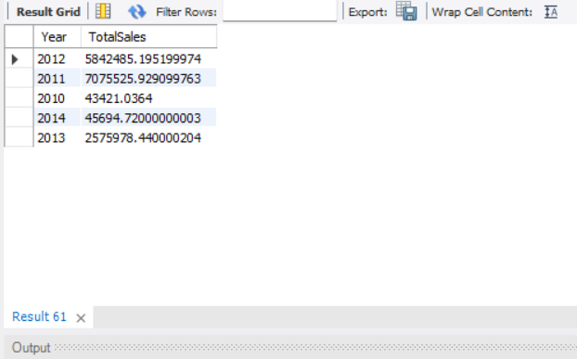
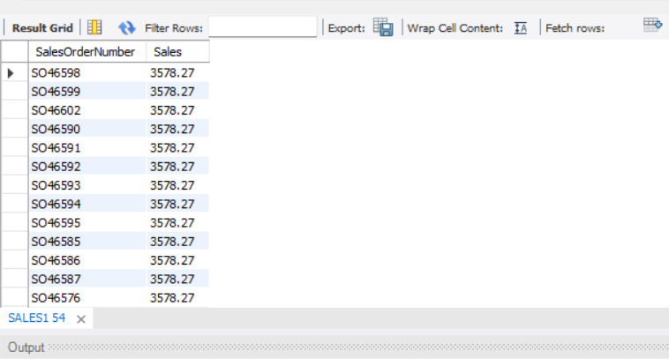
SQL

Slide 13
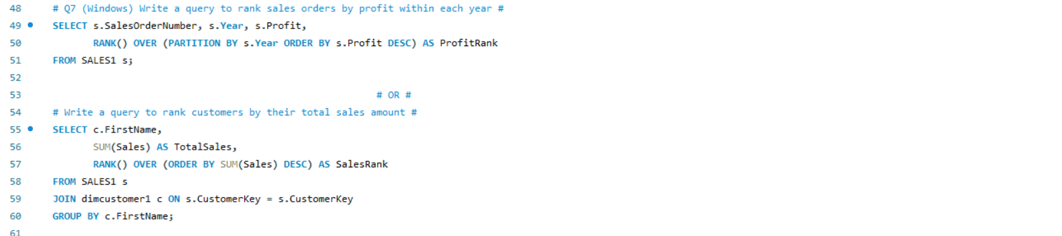
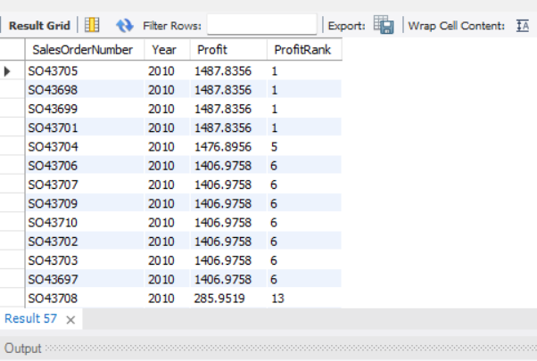
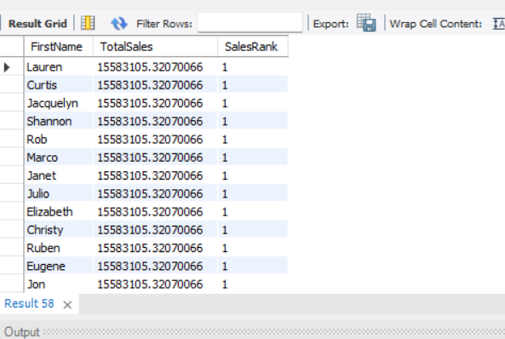
SQL

Slide 14

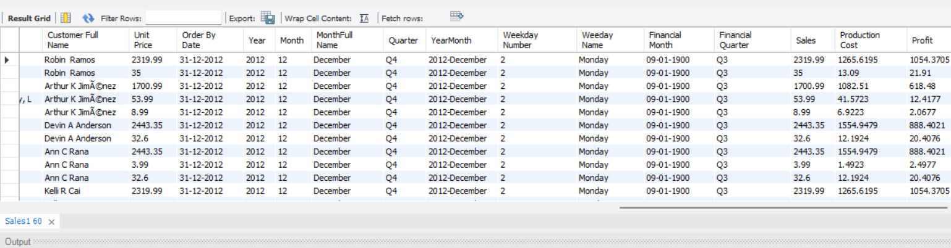
SQL

Slide 15
Key Takeaways
Data-Driven Insights:
Helped uncover sales trends, customer preferences, and regional performance.
Operational Efficiency:
Enabled quick access to critical KPIs across multiple tools.
Scalability:
The dashboards are scalable for future automation and updates.
Strategic Impact:
Supports targeted decision-making through interactive visuals.

Slide 16


